Slide 1
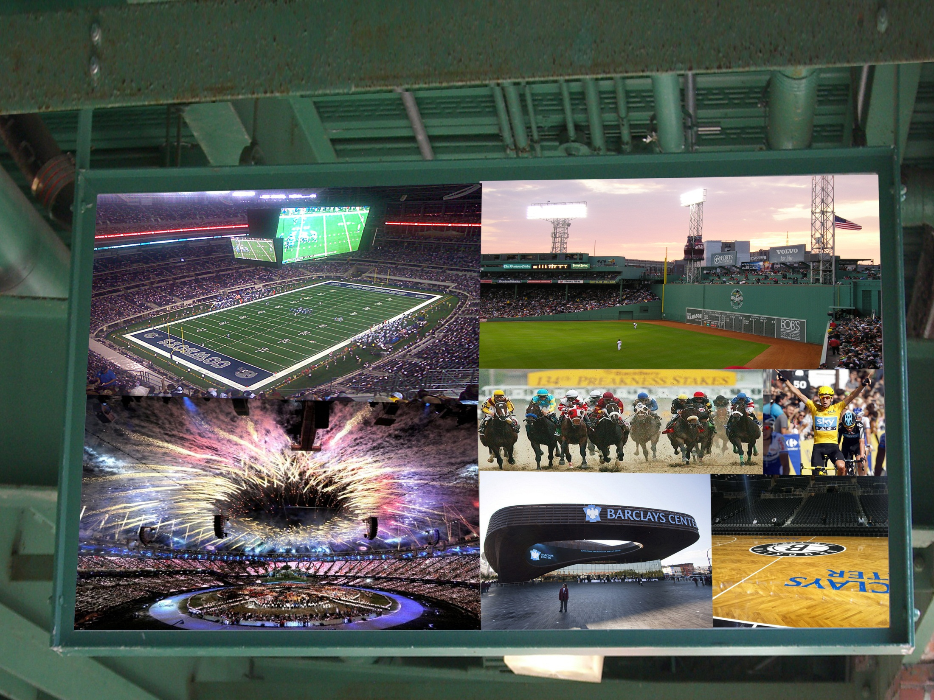
Sports Distribution
2.2 Event & Media Distribution

Slide 2
Stadium as “Place”
Sports – produced & consumed at same time
Sports – produced & consumed at same place
Stadium – IS the distribution method
Stadium – adds to the “effect” of the event

Slide 3

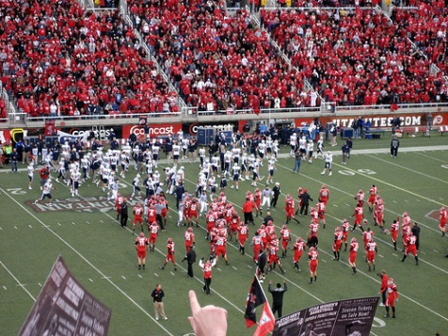
Place=Distribution
Sports are produced and consumed simultaneously
The Stadium, Arena, or Venue serves as both the location and the method of distribution for the event
The media also provides distribution of sports events
  News, TV, Pay-Per-View, Radio, Tablet, Internet…
Notes:
36

Slide 4
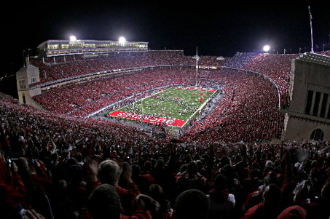
Distribution of Events
Attendance
Gate or Gate Receipt
Fan Fun Events
Ancillary Events
Notes:
37

Slide 5
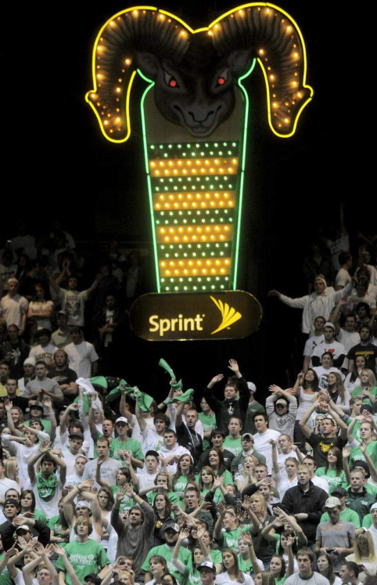


Fan Involvement in Events
Many ways that fans shape and effect games
  “Home Court Advantage”
  Noise meters
  Attendance records
  Ticket Prices & “Scalping”
  Media Input & Purchasing
    DirecTV, Satellite, Pay-Per-View

Slide 6
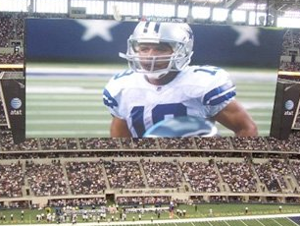
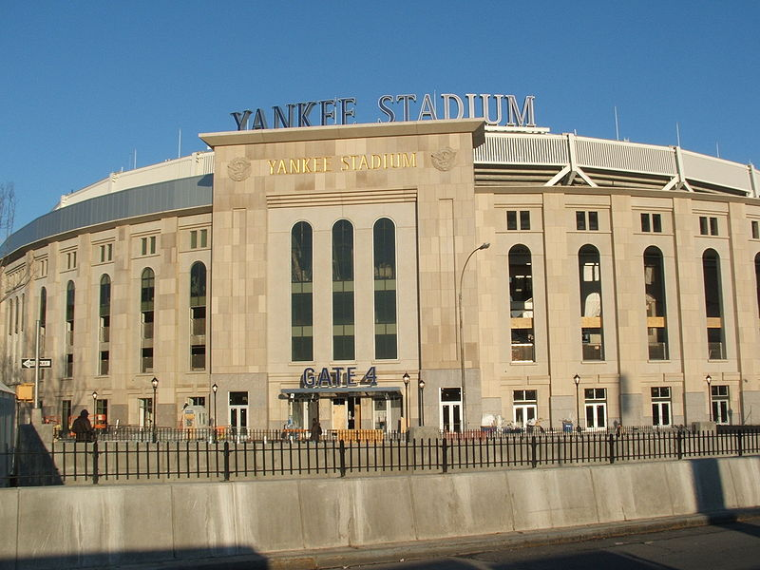
New Stadia
Dallas Cowboys Stadium
New Yankee Stadium
Cost: $ 1.3 billion
Seating Capacity: 80,000
Cost: $1.5 billion
Seating Capacity: 50,086
New Technology with :
WiFi, Restaurants, LCD Screens, Ergonomic Seats...

Slide 7
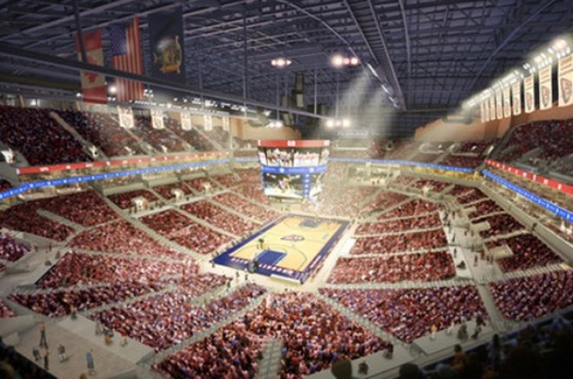
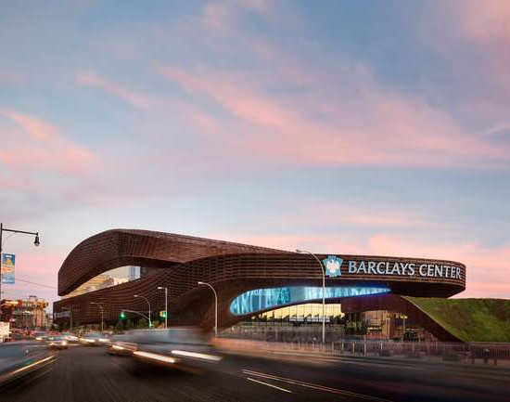
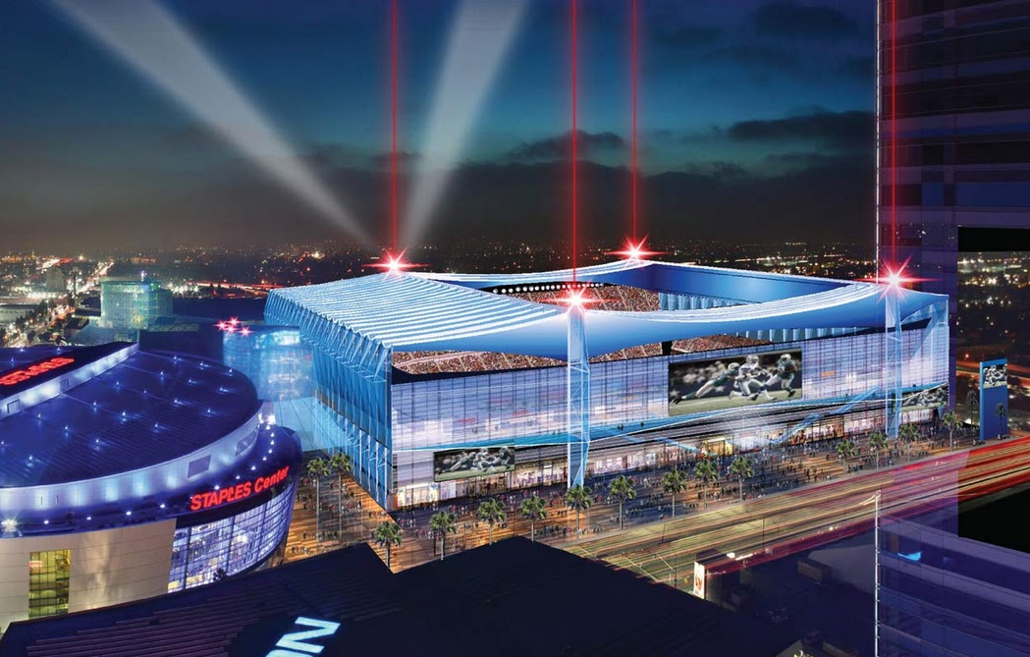
New stadia
Farmers Field
Barclays Center
New Jersey Nets
Los Angeles
  Future Venue???
  NFL, Superbowls
  NCAA, Bowl Games

Slide 8
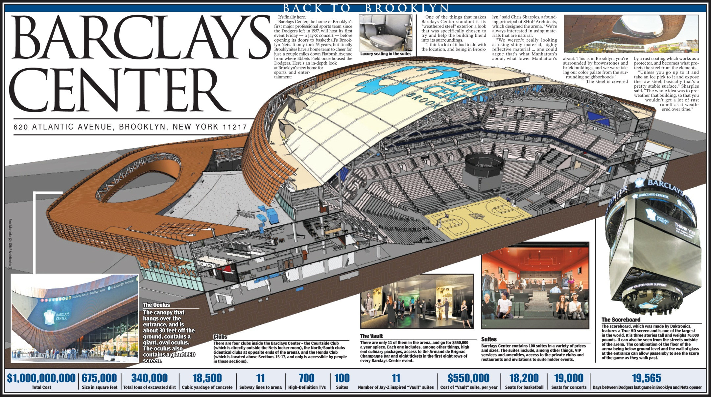

Slide 9
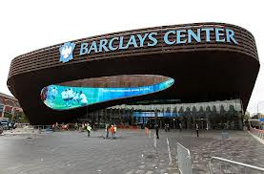
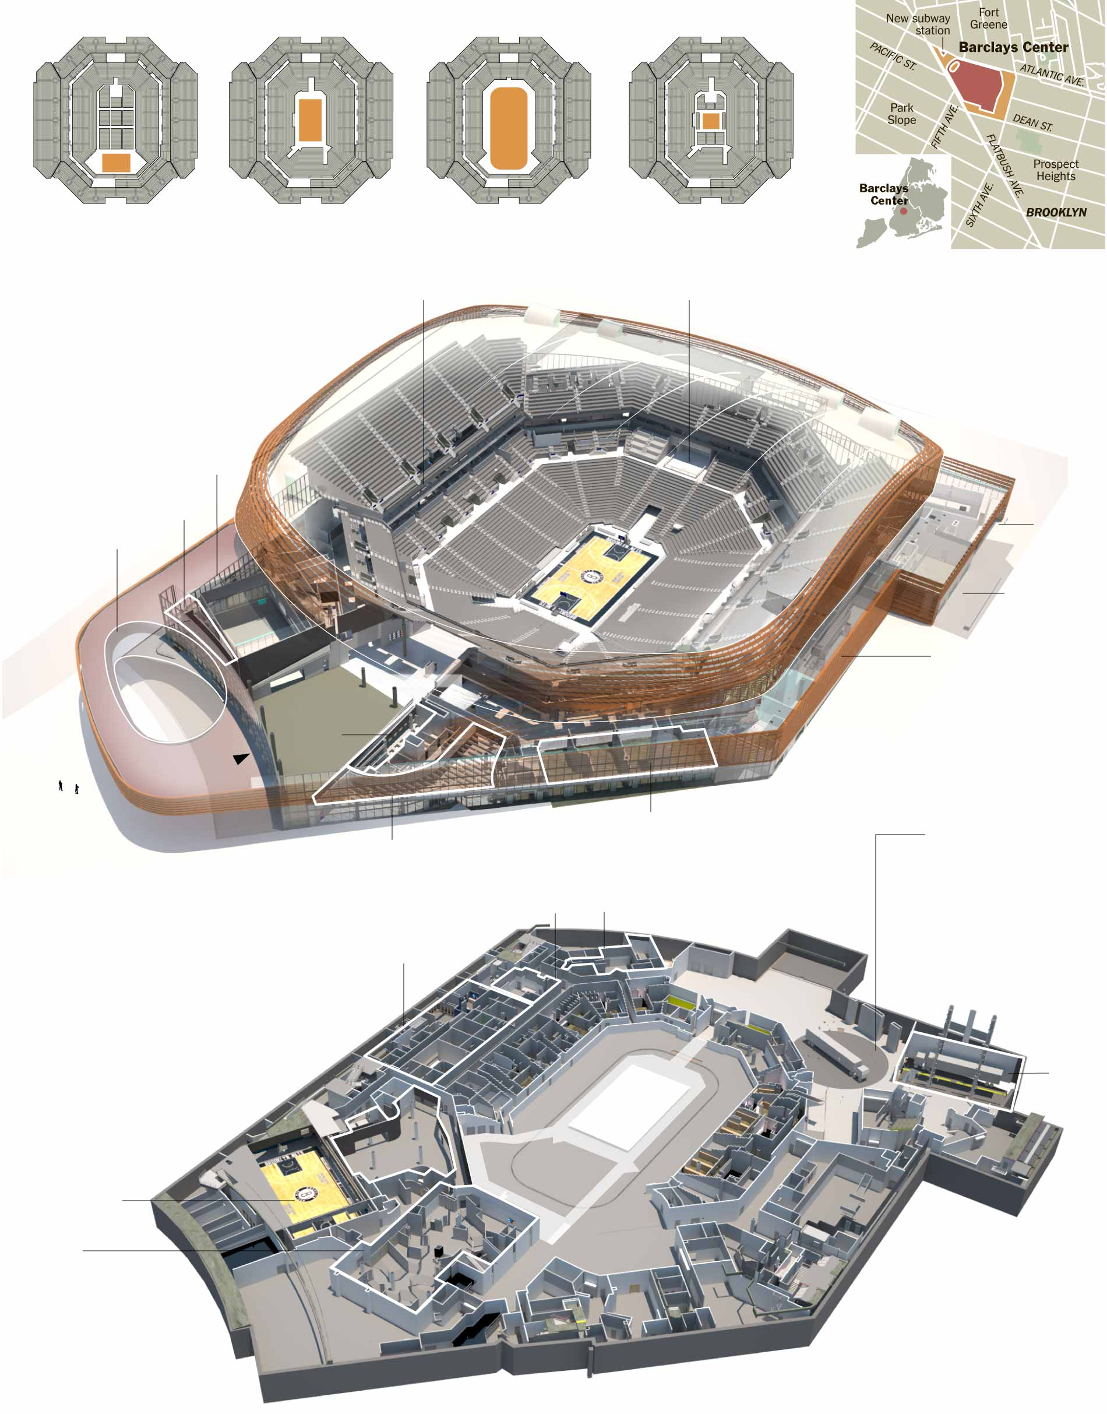
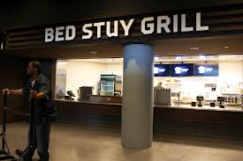
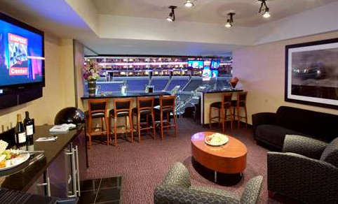
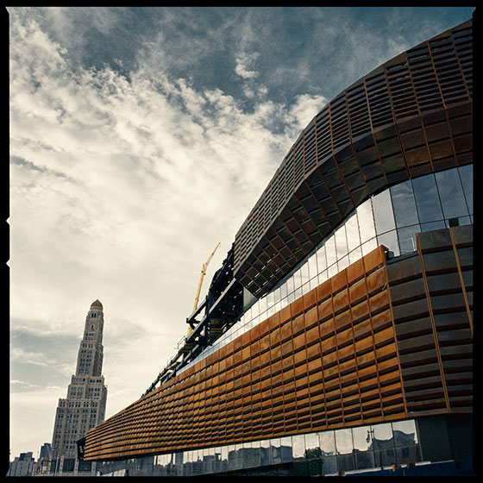

Slide 10
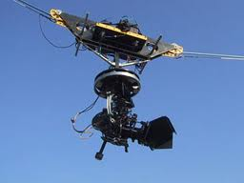
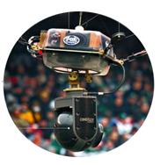
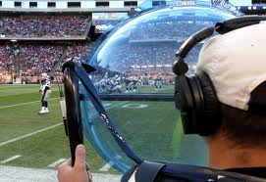
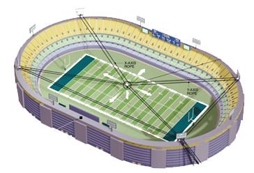
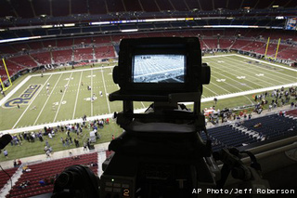
Game Coverage

Slide 11
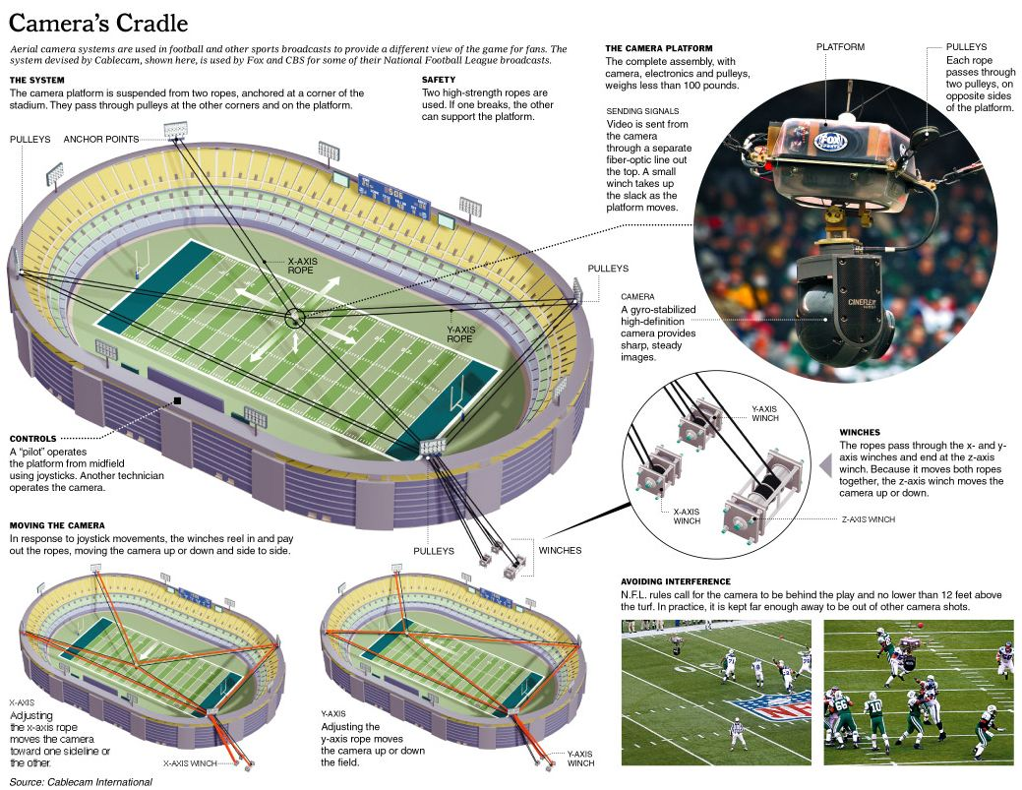

Slide 12
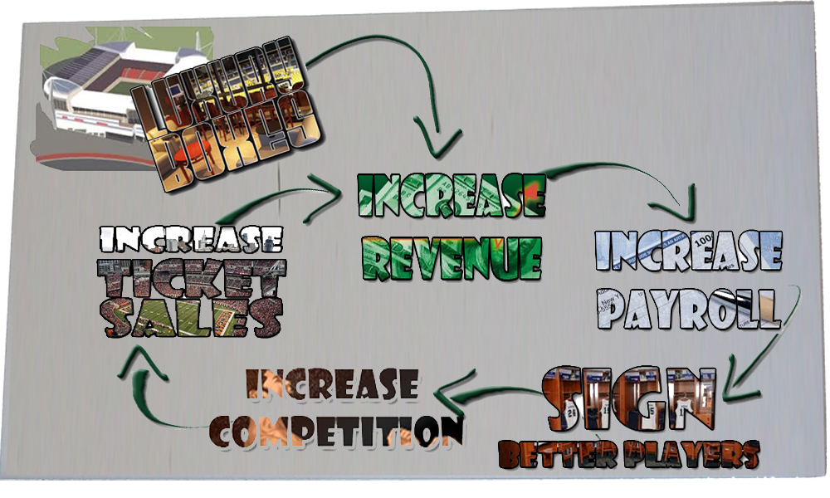
New Stadium with Luxury Boxes
  Adds over $100 Million Annually to Team.

Slide 13




Ticket Distribution
Variable Pricing
  Price based on the time of the year, day of the week, and popularity of the opponent.
Team & Venue Sales
  Sales: Face Value of Ticket
  “GATE”➔ Total Ticket Sales for Event
Ticket Brokers
  Sales Price + Service Charge
    Game Marketing, Advertising, Tech Support
    Customer Service, Sales Force

Slide 14
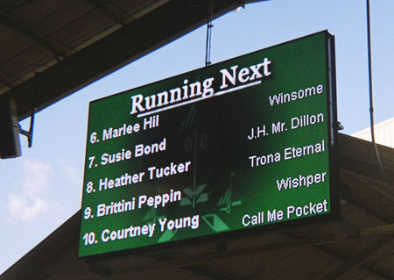


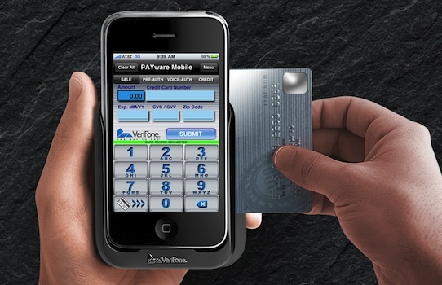
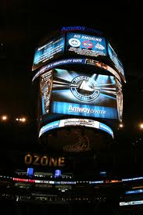
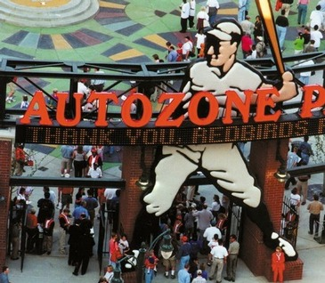
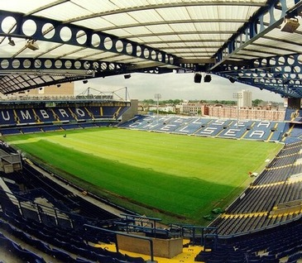
Goal of Stadium
Create Value in Time Spent @ Park
Attract More Spectators
Make “Experience” Bigger & Better
  DAKTRONICS ®TECHNOLOGY
  Seat side concession ordering, replay, player statistics, . . .
Define: REVENUE STREAM

Slide 15




Media Distribution
Delivering Sports Events with MEDIA
  Television -- Radio
  Internet -- Satellite
  Tablet --Smart Phone

Slide 16





Rights to Distribution
Networks Buy “Rights” to Broadcast
  Advertisers Buy Advertising Time During Broadcast
  Sponsors pay for Exposure from Broadcast
Media Revenue goes to Team or League
  “REVENUE SHARING”
  “MEDIA RECEIPT”

Slide 17


TV Facts
A 30 second Super Bowl ad in 2012
    $4 million
University of Utah TV Revenue
    2011- $ 3 Million
    2012- $ 7.5 Million
    2013- $ 11.5 Million
    2014- $15 Million
BYU earns $ 4 Million per year from ESPN.

Slide 18






Reliance on Media Money
Sports Revenue in 2010
MLB $7.2 B
NFL $9.0 B
NBA $4.1 B
NHL $3.0 B
NCAA $757 M
NASCAR $645.4 M

Slide 19
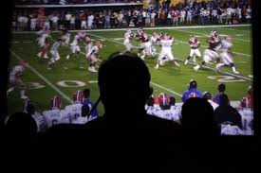
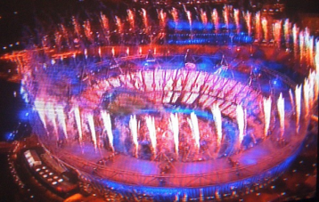






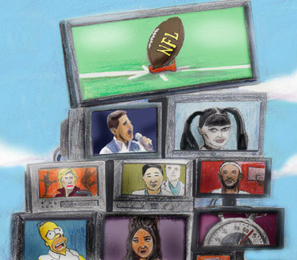

Benefits of Media Rights
Guaranteed Mass Audiences
  Specifically Young Male Target Market
Rating are Declining in All Programming
  Slower in Sports Programming
NFL remains the most watched programming
  In 2011, nine of the top ten highest rated national broadcast were NFL programming.
Companies can use sports to
Create & Maintain their IMAGE

Slide 20




















Cable & Satellite
“Direct Broadcast”
  Cable & Satellite Services
  DirecTV, Dish Network, Digital Cable
Offer Specialty Broadcasting
  Provide Specialty Target Markets
  Provide Advertisements & Pay Per View
  Provide Statistics on viewership

