Slide 1
Marketing The Event
4.1 The Event

Slide 2
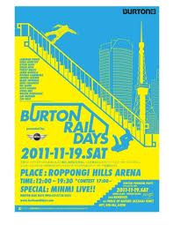
Standard Four
Students will assess the importance of event marketing and entertainment in sports.

Slide 3
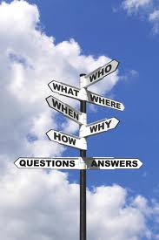
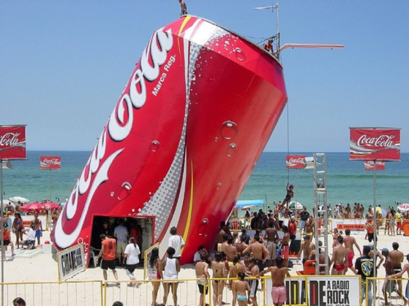
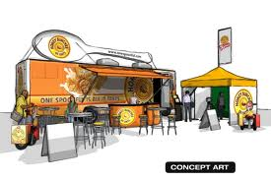
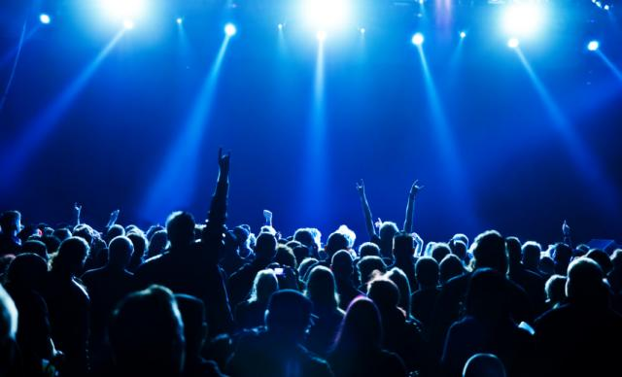
Event Marketing Defined
Applying marketing principles to the marketing and promotion of an event.
May or may not be team oriented
Superbowl, NBA Finals, Stanley Cup Playoffs
May or may not be “mainstream” sports
X-Games, World Chess Championships
Movie Premier, Back to School Night
Notes:
50

Slide 4
Event Marketing & Entertainment
Sports Properties
Types of Properties
VENUE – Stadium, Arena, Track,
LEAGUE
TEAM or CONFERENCE
ATHLETE, SPECIAL EVENT
Uses of Marketing range from ticket sales to seat design
Concert, Meeting, Conference…
Notes:
55

Slide 5
The Field

Slide 6
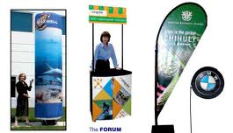
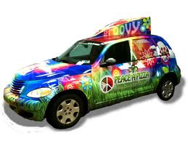
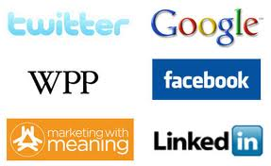
EVENT MARKETING
Marketing of the Event
Entertainment Offerings
Dates, Times, Location
Special Offering: Back Stage Passes…
Advertising & Promotions
Social Media
Event Evaluations
Other

Slide 7
Event Components
Concessions
Merchandising Opportunities
For Event
For Sponsors
Seating
Personal Seat Licenses*
Luxury Boxes**
Season Ticketing***
Staffing & Training
Social Media
Statistics
Follow Team/Player
Other
Notes:
51
52
57

Slide 8
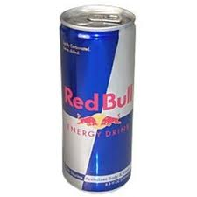
Brand
Brand:
A company’s identifying mark or logo

Slide 9
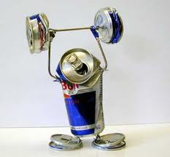
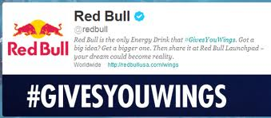
Branding
Leagues, Teams, Merchandise, and Events are often branded to aide in marketing efforts.
Branding:
a company’s or event’s efforts to develop a personality and make its products or services different from the competition.
Companies use different types of media including Social Media
Notes:
46

Slide 10
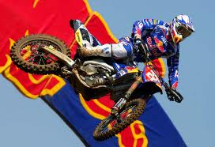
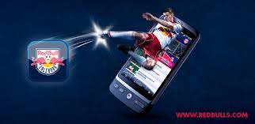
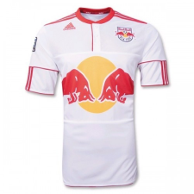
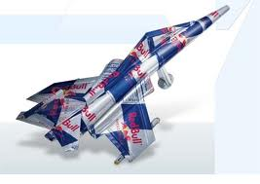
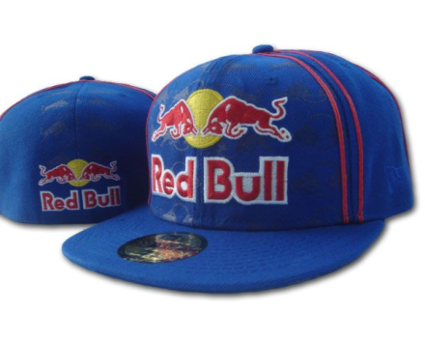
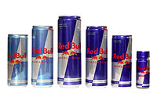
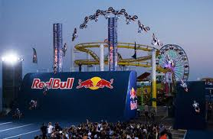
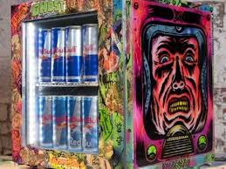
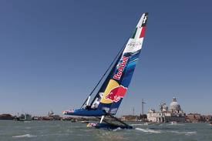
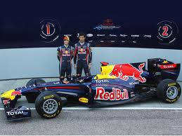
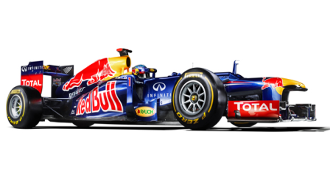
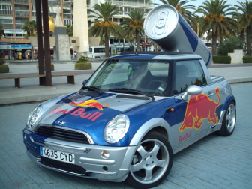
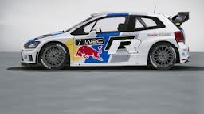

Slide 11
Branding
Event Branding Opportunities
Naming, Event Offerings
Promotions and Co-Promotions
Sponsorship Opportunities
Merchandising Opportunities

Slide 12
SPORTSCAPE
Why is attending a game better than watching on TV? THE EXPERIENCE!
The use of the venue to make attendance to a game “more than just a game”
Atmosphere, Color, Music, Motion
Sights & Smells, Tradition, Architecture
All of these factors and many more shape the Fan’s perception of the event and his or her role in that event
Notes:
59
60

Slide 13
Elements of Sportscape
Aesthetics
Music
Colors
Smells
Lighting
Motion
Concessions
Merchandise
Parking
Seat Comfort
Seat Access
Sponsor Marketing
In-Game Entertainment
Signage
Replay Screens
***These Four Elements generate income for your event!!
Identify WHAT these are and WHAT THEY MEAN at an event
Notes:
56
58

Slide 14
Event Evaluations
Evaluations are on-going during an event
Used to improve and manage offerings
Typically conducted by management & staff
Notes:
61

Slide 15
SWOT Evaluations
S = Strength
Things that went well, positive results
W = Weakness
Things that went poorly, room for improvement
O = Opportunities
Things/areas that can be improved, capitalized
T = Threat
Things which could become a problem, area of concern
Notes:
48
49

Slide 16
Component Evaluations
Sales Evaluations
Ticketing, Season Ticketing, Packages
Fan Enjoyment Evaluations
Fan Reactions, Consumer Evaluations
Return On Investment
Repeat Purchases – Individuals & Corporate
Sponsorship Evaluations
Venue Evaluations
Capacity, Perceived Crowding, Entry, Exit
Notes:
62

Slide 17
Return on Investment
Represents benefits of sponsors & advertisers for being involved in an event.

Slide 18
Standard 4.1 Projects
ID Sports scape elements for venue/event
Complete a SWOT Evaluation

