Slide 1
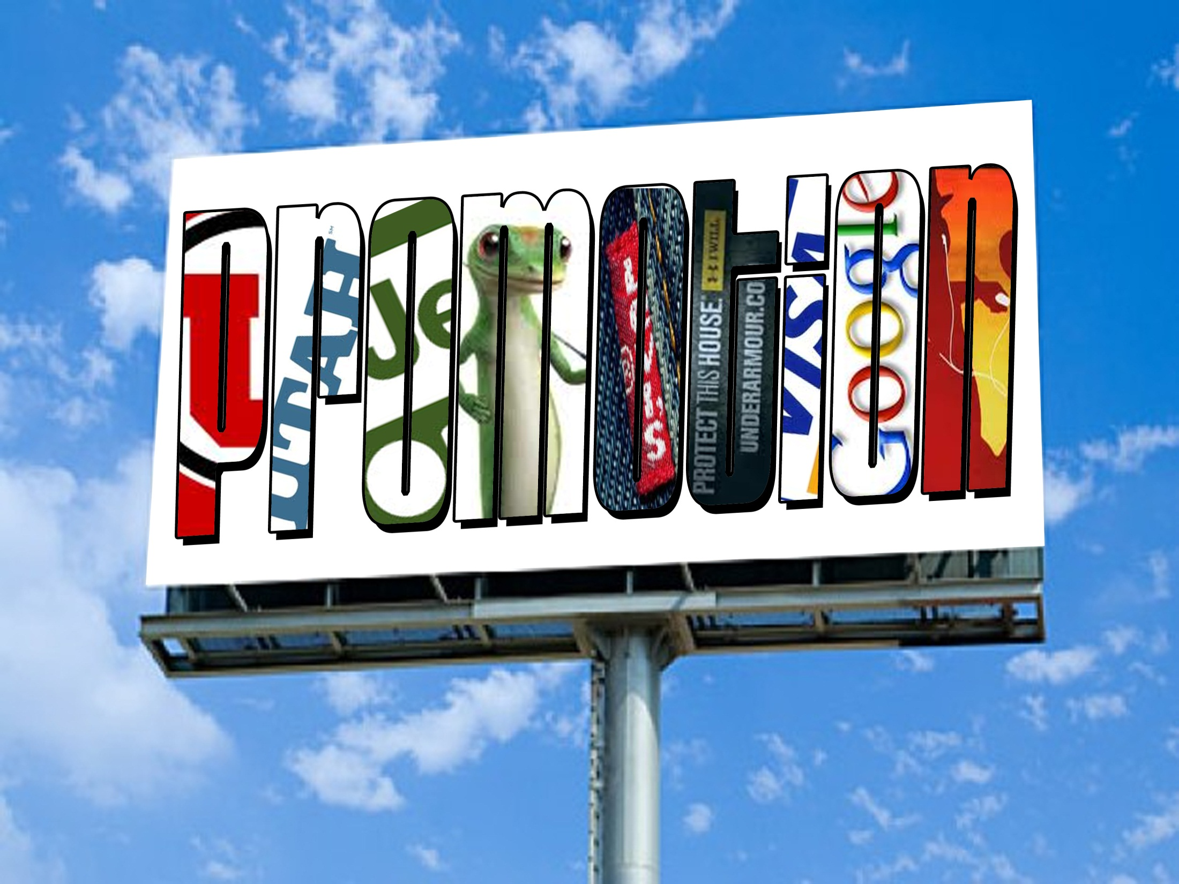
Standard 5

Slide 2
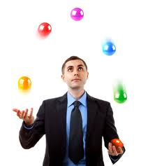
Standard Five
Students will discover the importance and elements used in developing a PROMOTION MIX to market sports businesses.

Slide 3

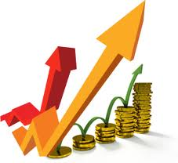
Promotion
  A marketing function needed to communicate information about goods, services, images, and/or ideas to achieve a desired outcome.

Slide 4



Role of Promotion
Inform
  Grand Opening
  New Product
  Updated Product (latest version)
Persuade
  Why this product over the competition
  Why this event rather than the other event
Remind
  We are still here, and you know you want one.
Notes:
64

Slide 5
Promotional Goals
  Increase Sales
  Increase Awareness
  Be Competitive
  Reach the Target Market
  Build Customer Relationship
  Develop Image
Which one is Direct?

Slide 6
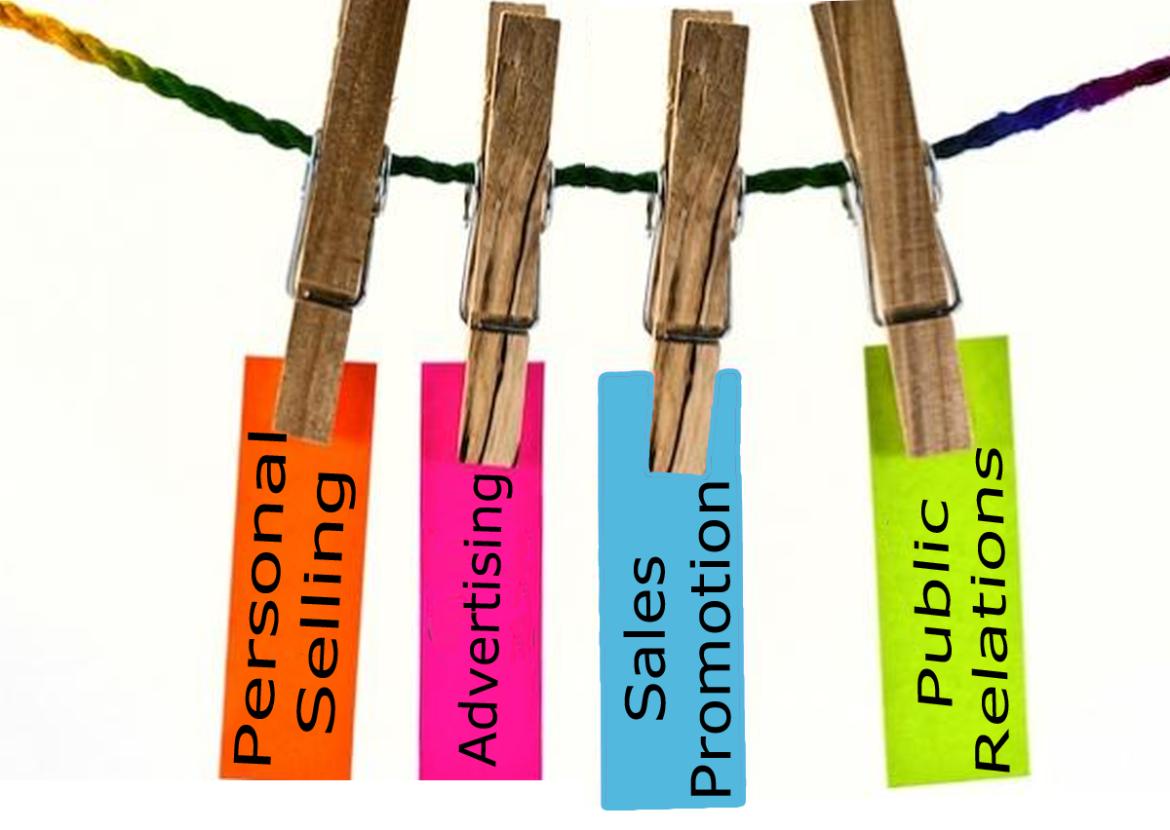
Promotional Mix
A combination of marketing communication channels that a business uses to send its messages to consumers.

Slide 7




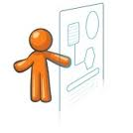

Personal Selling
The form of promotion that determines client needs and wants and responds though planned, personalized communication that influences purchase decisions and enhances future business opportunities.
Groups sales staff
Ticket agents
Salespeople
Telemarketers

Slide 8
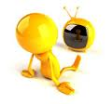

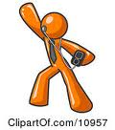


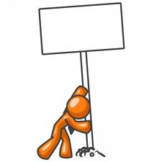
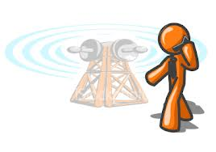
Advertising
Advertising: Any paid form of non-personal presentation of ideas, images, goods, or services.
Television
Radio
Newspaper
Magazines
Sponsorships
Outdoor
Product Placement
Social Media
Mobile Advertising

Slide 9
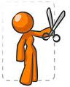
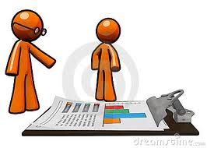

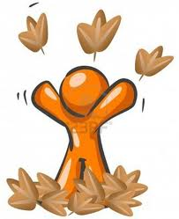


Sales Promotion
Marketing activities that are designed to create an immediate spike in sales
Coupons
Sales
Games
Contests
Give-a-ways
BOGOs
Bundling

Slide 10


Public Relations
Any non-personal presentation of ideas, goods, or services that is not paid for by the company or individual that benefits from or is harmed by it.
News releases
Press conferences
Television Show appearances
News features
Interviews

Slide 11
Media Types
    The message channels used by a seller to promote a good, service, or idea
    Broadcast Media
    Print Media
    Social Media
    Direct Mail
    Outdoor
    Specialty Media
    Other
Notes:
69
70
73

Slide 12
Advertising Schedule
Advertising Schedule: Schedule of promotional activities to be run prior to, during, and after an event.
Promotions are typically Run in a group or “Campaign”
Promotions typically have a common theme
Promotions typically use several media types
An advertising schedule organizes promotions & media types over a time period.

Slide 13
Ad Schedule
TIME
Television
Print
Print
Retailer Promotions
EVENT
Blimp
Radio
Internet
Social Media
Notes:
Internet needs to have social media (facebook, twitter…) added

Slide 14
Promotion Budgeting
1. Fund the Primary Promotion
  “main” promotion, campaign, efforts
  Primary focus for the company
2. Fund the secondary promotions
  “extra” promotions
  Typically run with retailers
  Provide ways to spur sales
  Provide ways to earn back costs
  Expand exposure/reach of promotions

