Slide 1
Factors in Selling Yourself

Slide 2
Factors in Selling Yourself
How long does it take to make a first impression?
  30 seconds or less.
  Initial emotional judgment made.
Are first impression lasting impressions?
  YES!!

Slide 3
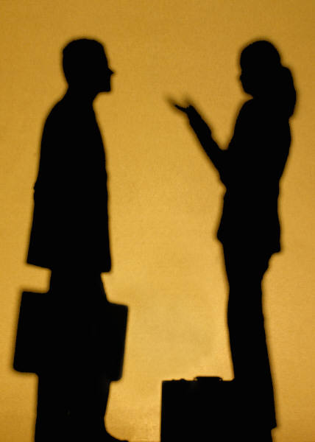
Contact – The first four minutes
“The first four minutes are the most crucial, or the average time in which strangers interact before they decide to continue or end their encounter with other people.”
  Leonard/Natalie Zunie, The first four minutes

Slide 4
First Impression Factors
55% comes from what we see
  Facial expressions
  Body Language
  Dress/Appearance
38% comes from tone of voice
7% comes from our words.

Slide 5
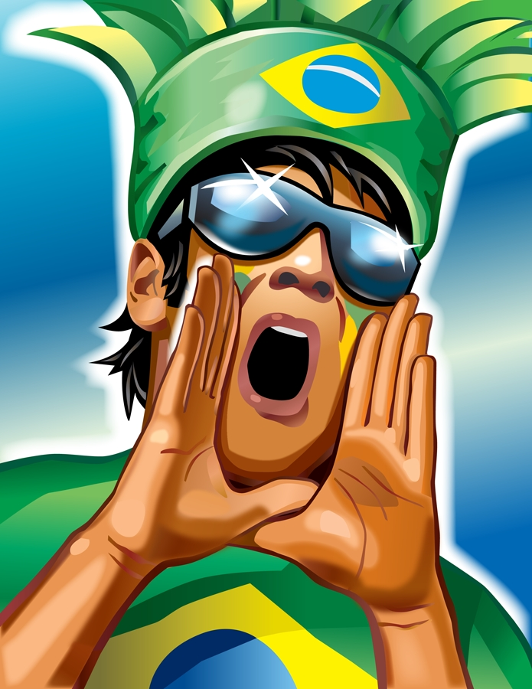
Communication Tools
Written language
Verbal language
Non-verbal.
  Body language
  Dress/Appearance
Personality

Slide 6

Body Language
Eyes
  Windows of the soul
  80/20 rule
  Attentive/Interest
Smile
  Light of the face
Gestures
  Animated
  Compatible
Movement
  Energy
Touching
  Bubble.
  Limit to handshake

Slide 7
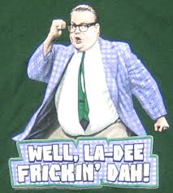
“Although you cannot control other people, particulary strangers, by reading their body signals, you can control the way other people will react to you if you control your own body signals.”
  John T. Molly, Dress for Success

Slide 8

Body Language Rules
One signal can have multiple meanings.
We speak in clusters.
Contradiction
  Believe the body signal.
Avoid annoying body signals.

Slide 9
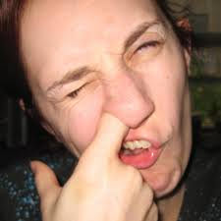
Annoying Mannerisms
Scratching the head.
Screwing at the ear.
Picking nose or teeth.
Clearing throat.
Chewing gum.
Cracking knuckles.
Hitching pants.
Pointing often.
Butting in.
Doodling.
Scowling/raising eyebrows.

Slide 10

Verbal Language
Tone of voice
  Greatest persuasive too.
“HOW” vs “WHAT” you say
Voice elements
  Rate (120 & 500 wpm)
  Pitch (high & low)
  Pauses
  Modulation

Slide 11


Slide 12
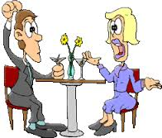
Verbal Language (cont.)
Use positive and persuasive words
  Easy, Money, Guarantee, Free, Save, Love, Proven, New, Health, Special
Figures of speech
  Simile (like, as)
  Metaphor (is)
  Euphemism (substitute)
    Let go = fired
    Big boned = overweight
    Au Natural = naked
    Correctional facility = jail

Slide 13
100 Top Executives Questioned
Does your company have a written or unwritten dress code?
  97 said yes to a written code
Would a number of people at your company have a better chance of getting ahead if they knew how to dress?
  96 said yes
Do you think employee dress affects the tone of the office?
  100 said yes

Slide 14
Do you think employee dress affects efficiency?
  52 said yes
Would you hold up the promotion of a person who didn’t know how to dress?
  72 said yes
Would you tell a young person that his/her dress was holding them back?
  20 said yes
Does your company turn down people who show up at job interviews improperly dressed on that basis alone?
  84 said yes
    (John T. Molloy, Dress for Success)

Slide 15
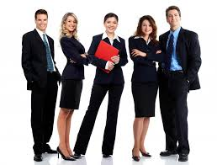
Surface Language
Dress and grooming
Key = Appropriate
Five Dress Guidelines
  Desired image
  Products/service you represent
  Type of people you serve
  Physical characteristics and body make up
  Dress rules

Slide 16
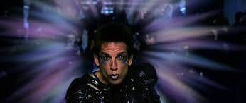
Discrimination
What we wear will immediately establish our credibility or likeness.
“In the business world, discrimination by appearance is a fact of life.”
  Ego Von Furstenburg

Slide 17
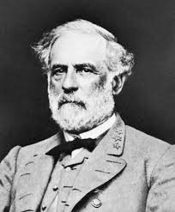
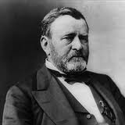
Grant’s Regret
When General Lee came to Appomattox Court House to surrender his army, he was immaculately attired in a new uniform and, at his side, hung a sword of extraordinary value. Grant was coatless and swordless, and was wearing the shirt and trousers of a private. “I must have contrasted very strangely,” Grant wrote in his diary, “with a man so handsomely dressed, six feet high, and of faultless form.” That fact that Grant had not been appropriately dressed for this historic occasion came to be one of his real regrets of life.

Slide 18
Personality
Descriptive tool
  Outgoing, shy, annoying, jovial, extrovert, introvert
Complex
  Traits, attitudes, experiences, emotional and physical characteristics
Developed throughout life
  First five years
Reprogrammable

Slide 19
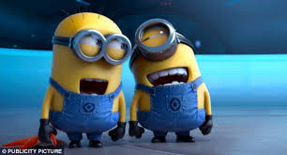
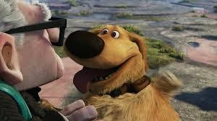
Build a Pleasant Personality
Socially sensitive
Call people by their names
Project a smile
Develop interest in others
Look people in the eye
Be careful with humor
Make others feel important
Be on time

