Slide 1
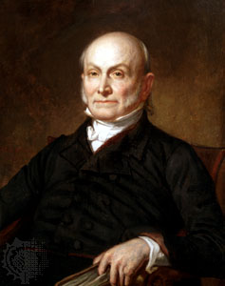
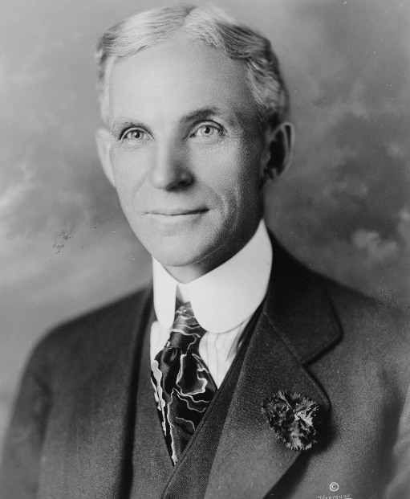
Lesson 10: Managing Conflict
“Patience and perseverance have a magical effect before which difficulties disappear and obstacles vanish.”
John Quincy Adams
“There are no big problems, there are just a lot of little problems”
Henry Ford

Slide 2
What is conflict?
Conflict is inevitable & will occur often, but it can be a positive force.
Whenever one person perceives his or her interests are being opposed or set back personal conflict will occur.
Group conflict occurs when sufficient breakdown in the normal activities between people that creates difficulty in working together to accomplish goals.

Slide 3
What are two types of conflict?
Conflict that is a positive influence and serves the interests of the organization is called “functional conflict.”
Can be considered “constructive.”
“Dysfunctional conflict” focuses on personalities instead of issues, and hinders the achievement of organization goals.
Conflict can be an asset or a liability.

Slide 4
What are the common causes of conflict?
Certain situations produce more conflict than others (must identify those causes!)
Incompatibility is most common cause of conflict.
Incompatibility as the result of personality differences or value systems.
2nd most common cause: Overlapping or unclear job boundaries.

Slide 5
What are the common causes of conflict?
Other common causes:
Inadequate Communication
Limited Resources
Unreasonable deadlines or policies
Decision-making processes
Unmet expectations.
Leaders must be proactive, and carefully read early warning signs.

Slide 6
What are five conflict strategies?
People tend to handle conflict in a pattern
This pattern becomes a behavioral style.
No single conflict strategy is best to use all the time.
Competing:
“I win, you lose” (high concern for self)
Accommodating:
Neglecting own concerns to satisfy others. Helps immediate situation but does not help in the long run.

Slide 7
What are five conflict strategies?
Avoiding:
Passive withdrawal from the conflict.
Short term fix.
Collaborating:
Problem-solving approach
Time consuming and complex.
Concern for self and others.
Compromising:
Requires give-and-take from both parties.

Slide 8
How can leaders manage conflict?
The critical issue is how to manage it productively to produce positive change without negative consequences.
Simplest way to manage conflict is to establish rules and procedures.
When rules don’t work the organization’s hierarchy is relied upon as conflicts are referred to a common superior.

Slide 9
How can leaders manage conflict?
Liaison is appointed for conflict resolution.
Can cut through bureaucracy for quicker resolution
Task forces.
When conflict is complex.
Outside arbitrators, consultants, & mediators used when organization cannot resolve conflict.
Company training in conflict management used to teach employees to cooperate, listen and learn, and respect other’s opinions.

