Slide 1
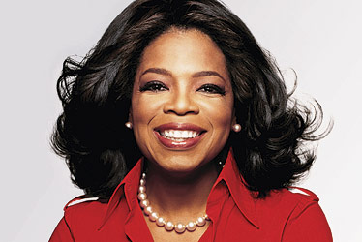
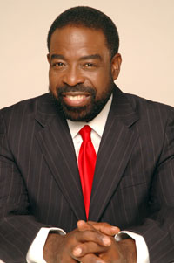
Lesson 11: Developing Power
“Don’t let the negativity given to you by the world disempower you. Instead give to yourself that which empowers you.”
-Les Brown
“I think education is power. I think that being able to communicate with people is power. One of my main goals on the planet is to encourage people to empower themselves.”
—Oprah Winfrey

Slide 2
What is Power?
Capacity to produce effects on others.
Try to change attitudes and/or behaviors of others
Power is exercised by followers and informal leaders as well as formal leaders.
Limited success without power; fact of life in modern organizations
The term “power” evokes mixed and often passionate reactions.

Slide 3
What are the five sources of power?
Two categories:
Socialized power: Power is directed to helping others (reward, coercive, legitimate power).
Personalized power: helping ourselves (expert and referent power)
Reward power: Ability to give.
Can come from all leaders
Coercive power: Fear and punishment.
generally a NEGATIVE motivator
dismissals, reprimands, etc.

Slide 4
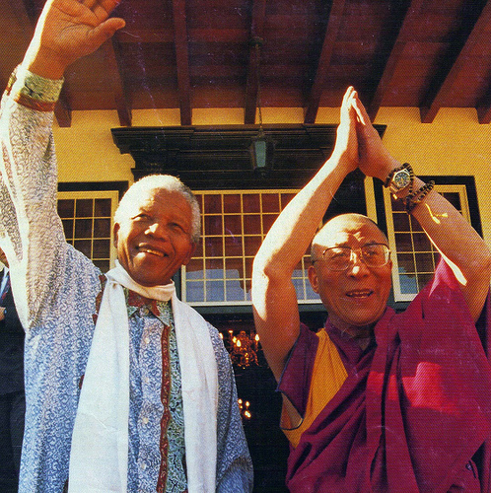
What are the five sources of power?
Legitimate power: Derived from formal authority
Appointed power.
Expert power: Specialized skills, knowledge, or expertise.
Referent power: Based on respect or admiration.
Considered a “personalized” power.
may be based on charisma or other personal traits (sports stars, heroes).

Slide 5
What source of power is best?
Use a combination of sources of power!
Good leaders learn to adapt and adjust their power sources.
Expert & referent power: very high positive impact.
Reward & legitimate: slightly positive.
Coercive Power: has a negative effect.
People should understand the risks and benefits of using each of the five sources and develop their skills accordingly.

Slide 6
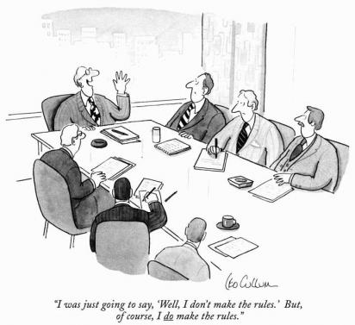
How do you develop power?
Developing power is a complex process. (Social Capital)
Planning, experience, and execution must be done to develop this power.
Power positioning is the conscientious use of techniques.
Power politics are intentional acts of influence.
Must understand and apply if necessary.
Power Symbols come from:
Physical traits, personality characteristics, and external physical factors.

Slide 7
Power Positioning Techniques
Create a following by establishing a reputation for being credible, reliable, and ethical.
Show that you are willing to set goals, take action and make decisions.
Look for ways to become visible by volunteering for special projects that expose your strengths & capabilities.
Acquire positions of authority and knowledge.
Develop your communication skills and ability to negotiate.

Slide 8
Power Positioning Techniques Continued
Develop commitment by displaying the inner drive that shows you are dedicated to excellence.
Network by learning to call on individuals inside and outside your organization who can help you reach your goals.
Learn how to be a team player by helping others reach their goals and objectives.
Understand your organization by being knowledgeable in the philosophy, politics, communication channels, & structures of the organization.
Develop confidence in how others see you by sharpening your public speaking skills and dressing professionally through appropriate attire

Slide 9
What is empowerment?
Empowerment: The Process of sharing power with employees.
DELEGATING is the key!
Granting decision-making authority.
Organizational members who share power tend to increase ownership, productivity, & commitment.

