Slide 1
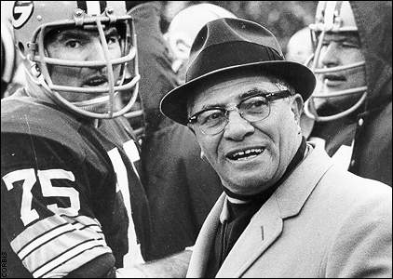
Lesson 12: Team Building
“Individual commitment to a group effort - that is what makes a team work, a company work, a society work, a civilization work.”
-Vince Lombardi

Slide 2
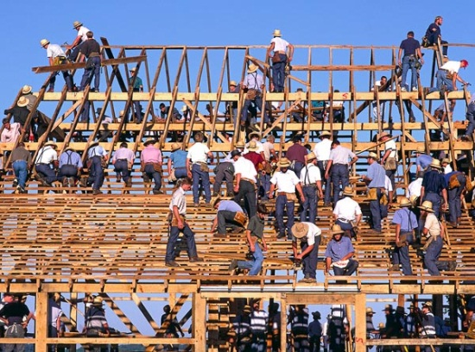
What is a team?
Defined: a number of persons associated together in work or activity.
A team takes 3-5 years to develop high levels of performance and success.
Example of cooperation and combined efforts of a team: Amish communities.
achieving common goals.
Pygmies
rely on trust as the foundation for leadership.

Slide 3
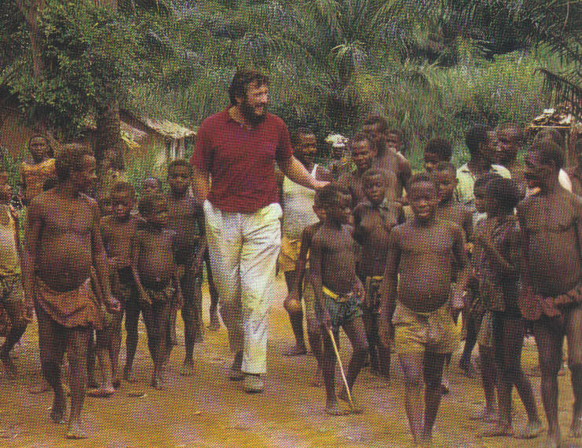
What is a team? continued
Functions of Pygmy Practices
developing codes of conduct.
respecting one other.
using egalitarian practices-both genders.
support & protect each other.
generate open dialog.
promote open and honest communication.
share common goals.
agree on values & beliefs.
unselfish needs
go to the entire group.
rotate leadership positions
(Apprentice).

Slide 4
What are three types of teams?
Teams have existed since people began performing complex tasks.
Problem-solving team (since 1900’s).
Consists of 5 to 12 from different departments.
“Quality Circles” … 70’s … created by Japanese.
Special purpose teams (evolved in mid 80’s).
Self-managed team.
most common.
5 to 15 employees produce an entire product.
Teams allow participation in decision-making and yields more satisfied employees.

Slide 5
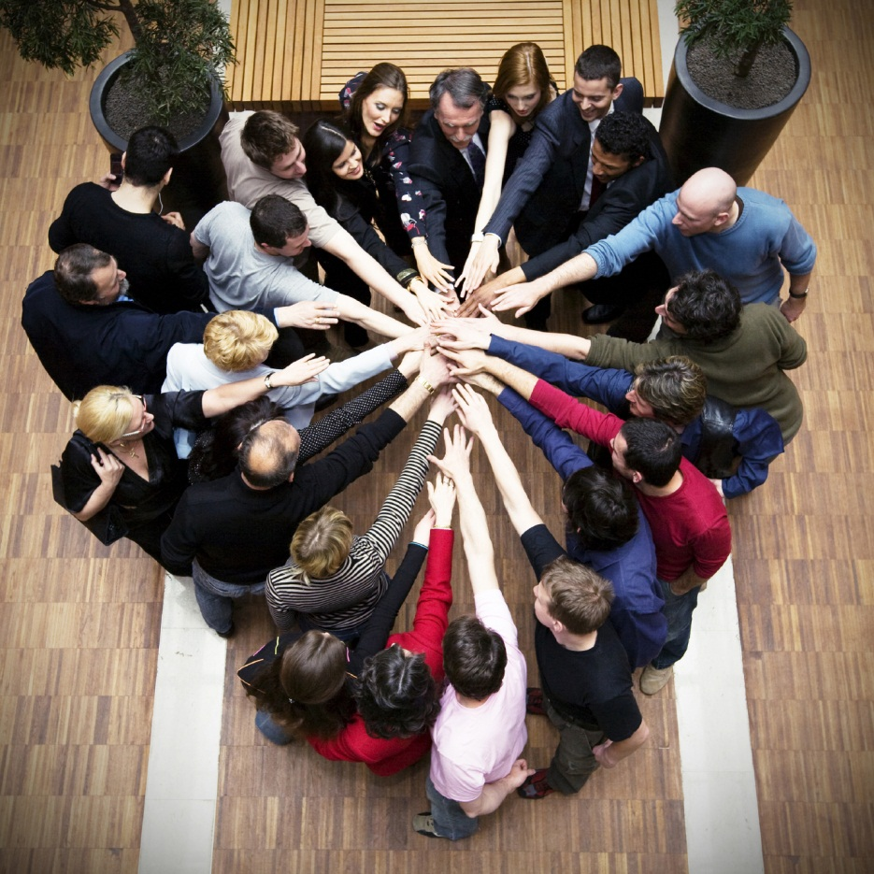
Advantages of team structure?
Over past 20 years - an increase of efficiency, flexibility and performance because of team structures.
Teams outperform individuals by 50%.
Overall performance increase because
Complementary skills and experience.
Teams support real-time problem solving & flexibility.
They provide a unique social dimension.
Basically, they have more fun!

Slide 6
What makes a high performance team?
No single formula, but there are several key factors.
Collaborative climate: work well together in pursuit of meaningful goals.
Climate includes clearly identified roles.
Clear sets of responsibility and accountability.
Clear lines of communication, record keeping, documentation, and developing feelings of trust.
Must insure honesty, openness, consistency and respect.

Slide 7
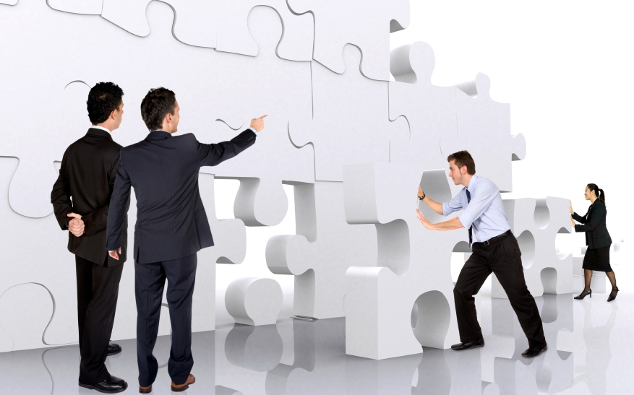
High performance teams Continued
Structure & performance:
Effective teams are results driven.
Some teams need high structure, some need less structure.
If creative solutions are sought then less structure is needed.
If more structured objectives are needed then the team may need more structure (military).

Slide 8
High performance teams Continued
D. Diversity:
Having a diverse team gives variety and unique skill-sets to perform better.
Key to diverse teams is integration.
Facilitated through effective communication.
Effective strategies to deal with conflict.
Focus on group rather than individual goals.

Slide 9
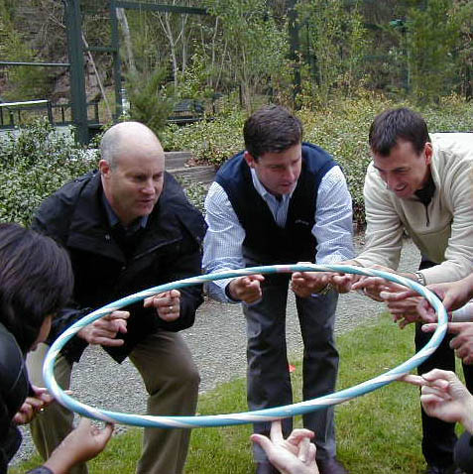
High performance teams Continued
Attitude:
High performing teams cultivate attitudes of enthusiasm, energy, respect and results oriented.
Low performing teams focus too much on the team itself.
Commitment: One of the most important factors of successful teams.
Are committed to one another.
Comes from spending time together.
Caring on a personal level.
Understanding the intricacies of each member of the team.

Slide 10
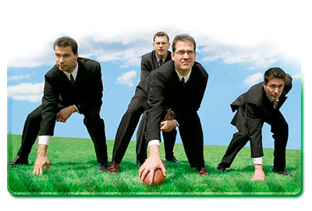
High performance teams Continued
Several external factors that help team to perform optimally.
Flexibility: Remove unnecessary formalities.
Responsibility: Give people opportunities to have ownership.
Clear standards.

Slide 11
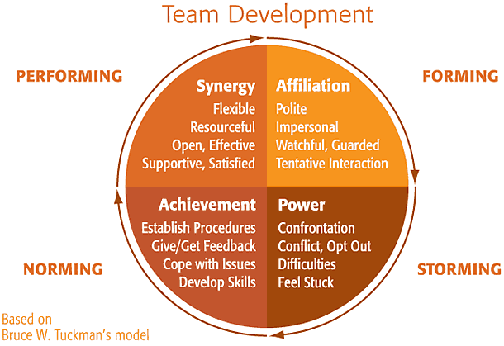
Stages of Team Development
No exact model for measuring stages, but… Four discrete stages as written by Bruce Tuckman attempts to define these.
First Stage: Forming
Represents the initial stages of team development.
get to know each other
surface-level.
Rely on leader’s direction
Usually unclear roles of the team.

Slide 12
Stages of team development continued
Second Stage: Storming.
Once a group begins to form differences, conflicts, and challenges begin to emerge.
Problems such as power struggles, emotional issues, and jockeying for position tend to happen.

Slide 13
Stages of team development continued
Third Stage: Norming
Begin to understand each others strengths and weaknesses and find strategies that allow for habitual patterns.
Roles & responsibilities are clearly defined.
Processes are beginning to form.
Mutual respect begins to occur for one another.

Slide 14
Stages of team development continued
Fourth and Final Stage: Performing.
Team has one clear vision.
Individuals have discovered their own strengths & weaknesses.
Teams make their own decisions.
They are autonomous from their leaders.
Members take care of each other.
Issues dealt with within the team itself.

Slide 15
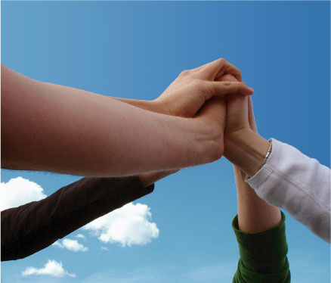
What is teambuilding?
Team building is a series of activities designed to solve problems.
Requires that each team participant accept the team goals and take ownership of the results.
Results in synergy. Which is when the whole is often greater than its parts.

Slide 16
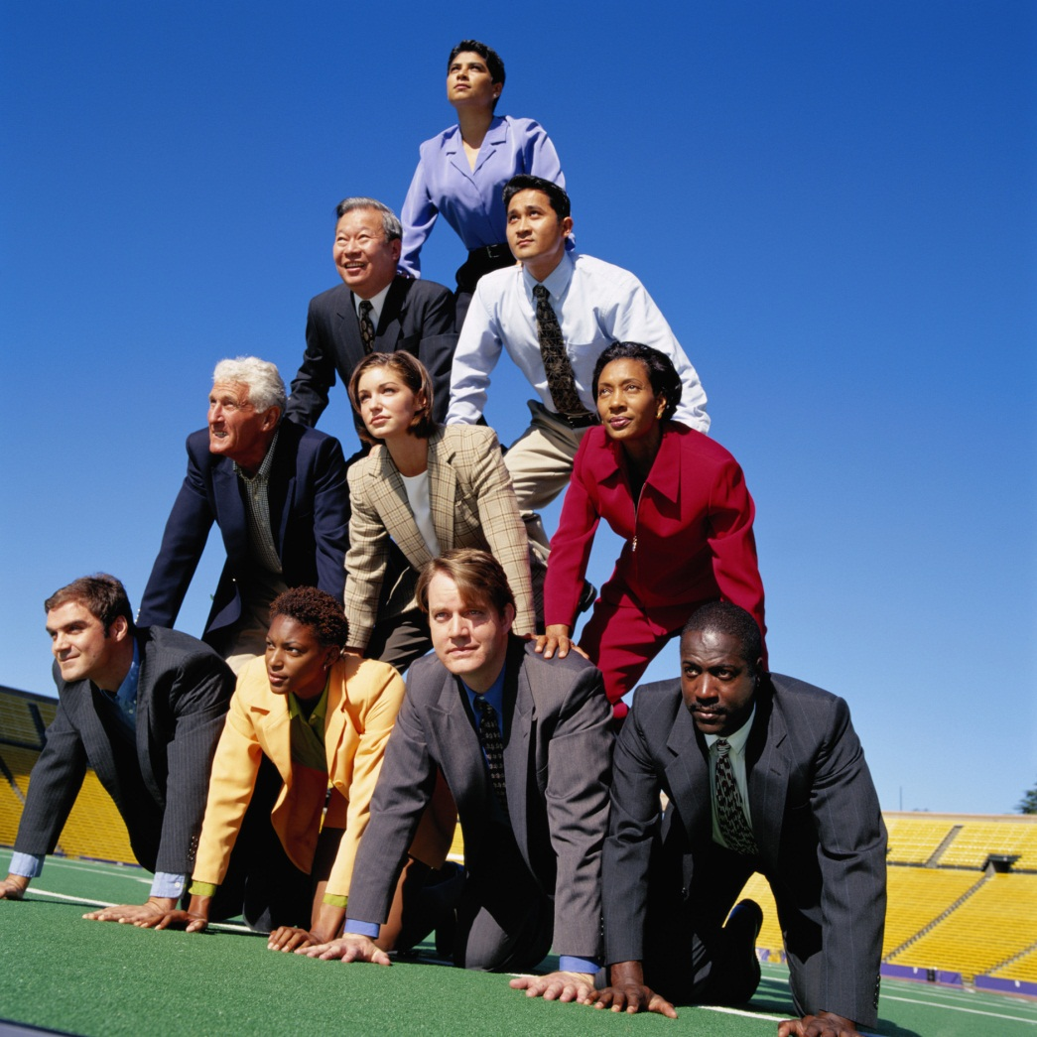
What is teambuilding? Continued
When building high performance teams, several practices should be considered
Develop urgency & direction.
Select those based on skill & potential.
Watch the first meetings for interactions.
Setting mini goals and celebrated victories.
Creating new challenges.
Member should spend time together.
All teams need positive feedback.

Slide 17
How to build an effective team?
When teams members cooperate, powerful results are achieved.
Interdependence happens when roles are identified clearly. Camaraderie occurs.
Leadership role: Critical for success.
Both formal role and sharing needed.
Coordination and communication is a MUST in today’s dynamic workplace.
Adaptability. Responding quickly and flexible.
Mission: Clear idea of the team’s purpose.

Slide 18
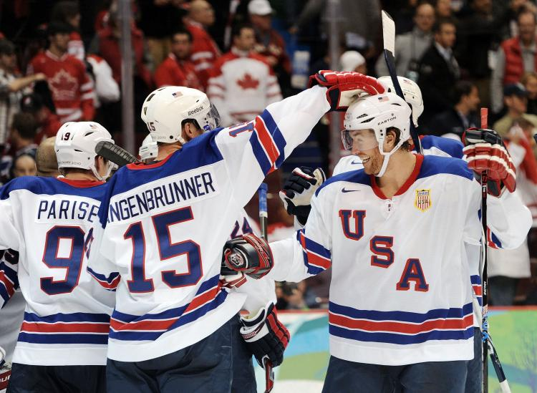
How do you become an effective team member?
Requires a Cross-section of talents & strengths.
May need to increase knowledge through cross-training.
Effectiveness comes from members understanding their roles & mission.
Aware of their strengths & weaknesses.
They have open communication.
Perhaps most important is to practice good human relation skills.

Slide 19
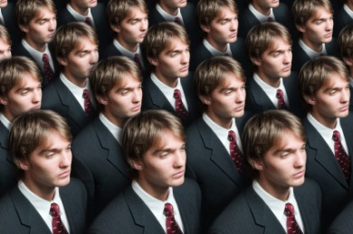
What are some team watch outs?
Having too many members can result in “Groupthink”: deciding collectively without individual consideration or attention to what is right.
Groupthink happens when group is
cohesive, and isolated.
under a directive leader.
under high stress.
when there is poor decision-making procedures.

Slide 20
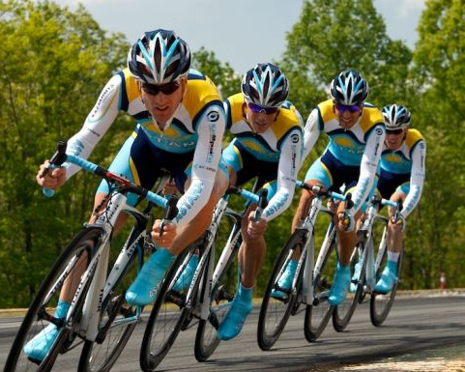
Team watch outs continued
Symptoms of groupthink:
illusion of vulnerability.
belief in moral correctness of the group.
stereotype views of the out-group.
ignoring contrary viewpoints.
illusion of unanimity.
individuals who protect the leader.

Slide 21
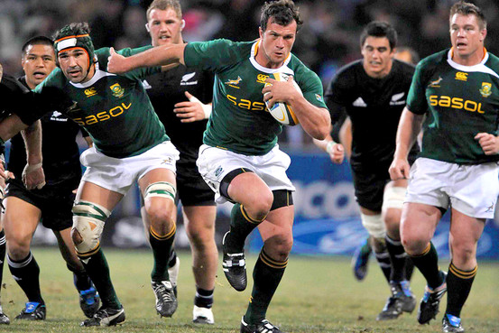
Team watch outs continued
Choosing the right people.
using “tools” such as screening instruments to identify good candidates.
Teams that do not monitor can see performance efforts reduced.
avoid complacency.
monitor themselves to improve their systems, processes, practices.

