Slide 1
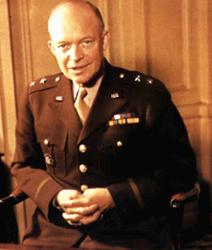
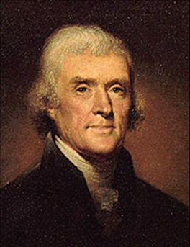
Lesson 14: Ethics
“A people that values its privileges above its principles soon loses both.”
-Dwight D. Eisenhower
“Honesty is the first chapter of the Book of Wisdom.”
-Thomas Jefferson

Slide 3
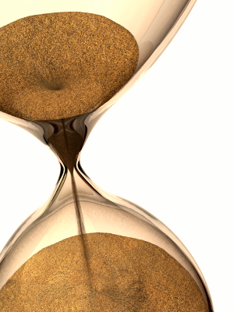
1. What is morality?
Morality: The behavior of making value judgments.
We are faced with ethical decisions every day.
What is right or wrong, good or bad, ethical or not?
People make decisions based a set of values established early in life.
Values are beliefs, principles, standards, and qualities considered desirable.

Slide 4
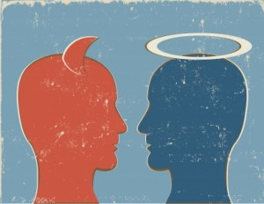
What is morality? continued
Value judgments involve a moral duty.
Example: You should not harm others.
Making moral judgments is part of what it means to be human.
How does one make moral judgments?
Religion: Involves deference to religious authority or scripture that directs decisions.
Mystical experience or flipping a coin.
Ethics.

Slide 5
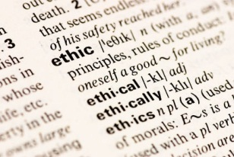
What are ethics?
Ethics: A philosophical study of morality.
Rational approach to studying morality.
Based on logical thinking.
Incompatibility of religion and ethics?
Closely linked to ethics – Integrity – which is a strict adherence to a code of behavior.
They are not only an individual, but also an organizational issue.

Slide 6
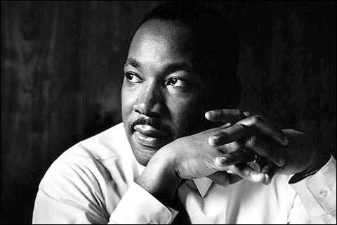
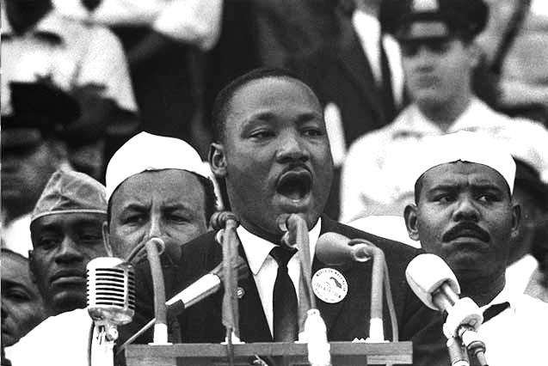
What are ethics? continued
Ethics are divided into two categories:
Character ethics and rule ethics.
Character ethics emphasizes the personality traits of a person.
Also are theories of a morally- good character.
In contrast with rule ethics, philosophers discerned good action from bad action such as the religious approach (ten commandments).

Slide 7
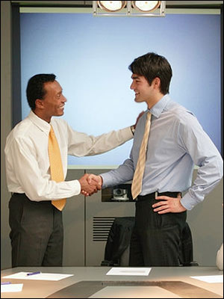
What are ethics? continued
Character and Rule ethics are interrelated.
Good character ethics need rules.
What virtues should you cultivate are based on principles you need to refer to.
Unless one has good character, he/she will have no motivation to follow moral rules.
Use of unethical practices is on the rise.
Organizations attempt to adopt a code of ethics.
Businesses often conduct seminars.
Hiring of outside consultants to help implement.

Slide 8
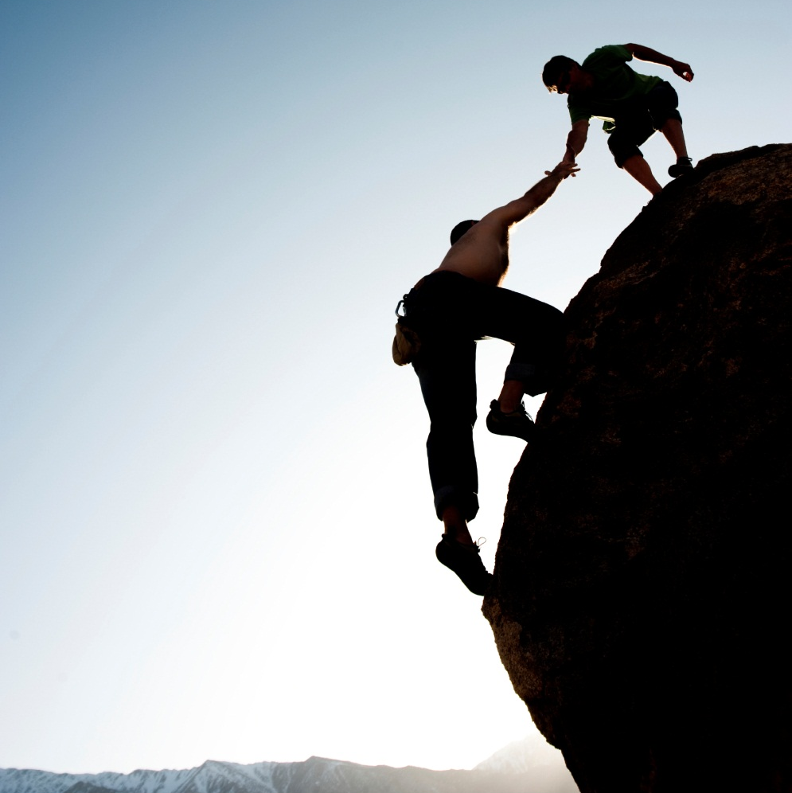
What is corporate social responsibility?
Ethics relate to societal institutions.
Organizations being held more accountable for their actions.
Aware of the impact their business has on the rest of society
Environment
Community
Employees
Consumers
Shareholders

Slide 9
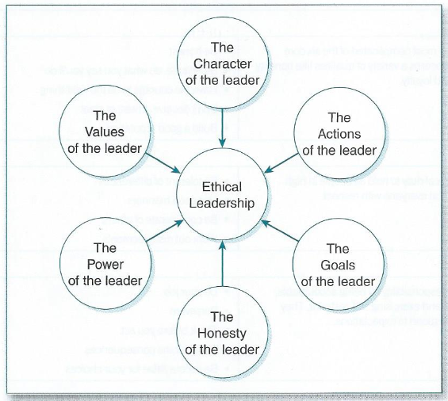
Leaders and ethical behavior.
Leaders play a vital role regarding ethics.
Factors relating to ethical leadership:
Character- qualities, disposition, and core values
Actions- ways leaders accomplish goals
Goals- identifying and pursing worthy goals
Honesty- telling the truth and being open
Power- capacity to influence
Values- ideas, beliefs, and modes of action

Slide 10
Six Pillars of Character.
Trustworthiness
Be honest
Be reliable
Courage to do the right thing
Don’t deceive, cheat, steal
Build a good reputation
Respect
Be tolerant of difference
Use good Manners
Be considerate of others
Work out disagreements
Responsibility
Do your job
Persevere
Think before you act
Consider the consequences
Be accountable for choices
Fairness
Play by the rules
Be open-minded
Don’t take advantage of others
Don’t blame others
Caring
Be kind
Be compassionate
Forgive others
Help people in need
Citizenship
Share with your community
Get involved
Stay informed: vote
Respect authority
Protect the enviorment

Slide 11
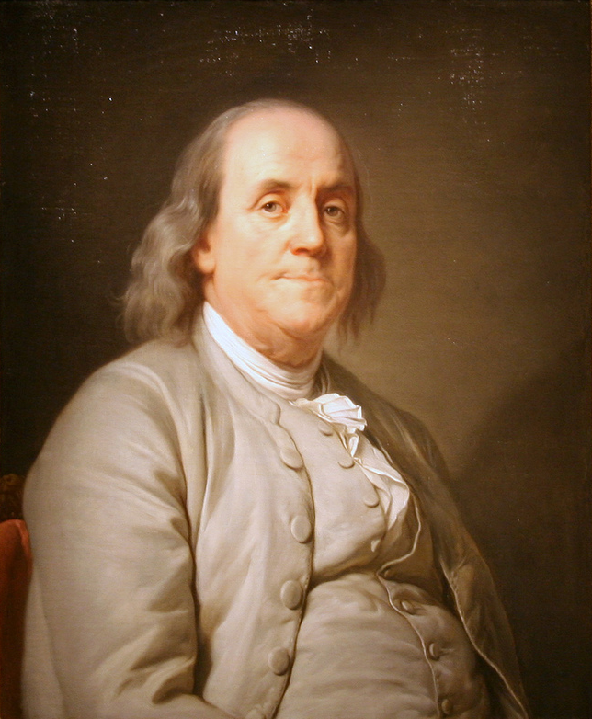
Leaders and ethical behavior.
Make decision today how you will lead!
You can make a choice today to identify and sustain your core values and beliefs.
Opportunity to follow a moral and ethical code of behavior.
Write down your core values & dedicate yourself. Build your own personal constitution.
This will pay large dividends to your life!

Slide 12
What would you do?
Brian Davis
called a two-shot penalty on himself that cost him a chance to win the Verizon Heritage, a decision that drew praise from PGA Tour rules official Slugger White, right.
Davis' error, a violation of rule 13.4 against moving a loose impediment during a takeaway, was indiscernible but for slow motion replays.

Slide 13
Golf is a game of inches, or in the case of Webb Simpson about a quarter of an inch. That was the distance the wind moved his ball as he went to address it on the 15th green Sunday at the Zurich Classic of New Orleans.
Because Simpson had set his putter down behind the ball — about 4 or 5 inches behind it by his account — it was considered taking a stance and when the ball moved, ever so slightly, he was then assessed a one-stroke penalty.

Slide 14
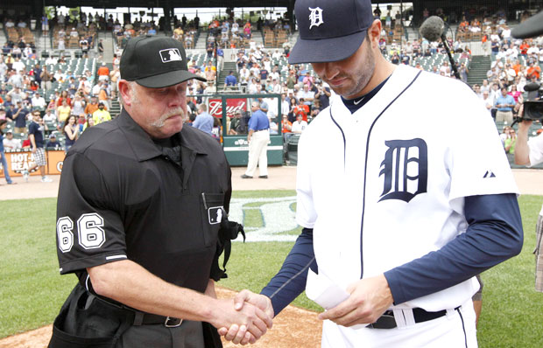
The Blown Call
Jim Boyce and Armando Gallaraga

Slide 16
Go to
Pollev.com/mrscoville778
Notes:
Poll Title: How would you characterize the pressure on you to succeed in school no matter the cost? https://www.polleverywhere.com/multiple_choice_polls/0FSQHD6jJa8cXm0

