Slide 1
Lesson Fifteen: Coaching
“TREAT PEOPLE AS IF THEY WERE WHAT THEY OUGHT TO BE
AND YOU HELP THEM TO BECOME WHAT THEY ARE CAPABLE OF BEING.”
~ GOETHE

Slide 2
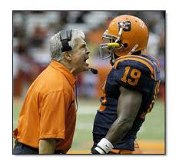
What is Coaching?
Coaching is usually associated with sports.
In business, coaching means personal achievement and excellence within any “meaningful life arena”
Defined as a process by which an individual works with another to facilitate higher level performance
Coaching is directly connected to leadership
It is about Pulling out the best in individuals
Not just directing them in what to do
Coaching is about helping individuals and teams discover their true potential.

Slide 3
How does Coaching Differ from other Helping Professions?
Coaching is one of the most modern approaches in developing potential
Coaching focuses on positive aspects of behavior compared to “problem-based” or pathological approaches
Pathological approaches (problem based):
Can be seen in Psychiatry; also in Psychology as well as social work
In contrast, coaching takes a more positive and proactive approach –
It is a new way of thinking

Slide 4
What are the Two Coaching Paradigms?
Two different mindsets dominate:
First is: Knowledge-based coaching
Similar to directive management
Referred as the “expert” model of coaching
Expert model often done with good intentions
Coach seeks to ensure performers receive all of the knowledge, insight, and skills necessary for high performance

Slide 5
What are the Two Coaching Paradigms? (cont.)
However there is a problem with knowledge based coaching:
Creates dependent relationship between coach and performer
Also can have negative effects
Decreasing performance because of inability to translate or understand information given

Slide 6
What are the Two Coaching Paradigms? (cont.)
Second is the facilitative coach:
Recognizes that the responsibility and answers to one’s performance problems are inside of the performer
We must “think” how performances are generated then utilize the proper processes to facilitate to desired performance

Slide 7
A Useful Coaching Model
First, coaching is a complex process but involves simple steps
There are four steps:
Setting goals
Understanding the person’s reality
Generating options
Organizing a way forward
This is the G.R.O.W. Model

Slide 8
Step 1: Goal setting
Setting a goal is important to help keep focus,
Important to be “smart”
SMART: Specific, Measurable Accountable to, Realistic, and Timely goals
When these criteria are used the discussion will be clear, understood, and reasonable in scope

Slide 9
Step 2: Understanding Reality
After setting the SMART goal, it is essential to understand your group’s or individuals reality
This is NOT about solving problems, rather it is to helping them think more clearly and how to solve their own issues, problems, or dilemmas.
Practice active listening. Which is taking an “active” role when hearing the issue
Able to repeat back what you heard and do so to their satisfaction
Improves the client’s motivation as well as strengthens the relationship with your client

Slide 10
Step 3: Generating Options
Listening helps generate options
During this phase you should try to identify potential actions to solve their problems
First seek out the client’s best thinking about options
Only, after pulling out or eliciting all options do you begin to offer additional insights
1. This keeps the client accountable for their own changes
2. Clients usually come up with own answers, which gives a sense of empowerment
3. Sets stage for client wanting to hear you
4. Having a client generate their own options gives client intrinsic motivation & ownership to take action

Slide 11
Step 3: Generating Options (Cont.)
Once you have pulled all of your clients options then you may ask permission to give suggestions
At this point, you have them choose from the many options that have been given and identify which to take action on
This leads to design a way forward

Slide 12
Step 4: A Way Forward
At this point:
A SMART goal has been identified, you have listened and discussed their current reality and generated options
A “way forward” is focusing on the options that your client felt were most important, and most motivating
These are considered “critical variables” of performance
You then can create an action plan or a way forward

Slide 13
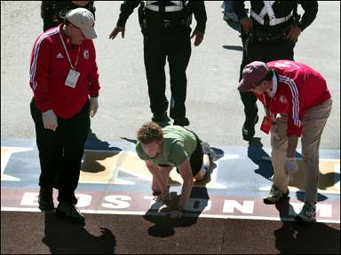
Useful Coaching Model (cont.)
By doing these 4 phases of coaching it helps increase the “decision speed” of the client
Helping to focus their actions and make decisions that will maximize performance
Conducting G.R.O.W. sessions gives confidence in his or her skills
Coaches do not have to be experts
Coaches are actually less of an expert than clients
A coach focuses more on helping, generate ideas, and act on skills the client already knows.

Slide 14
What is a Useful Model for Feedback
Feedback = a critical learning skill
Helps us Learn and grow from our experiences
Simple principles & methods for giving and receiving feedback.
Proactive approach to improve performance
Three questions frame the feedback process
1. What is working?
2. Where are the problems?
3. What can we do different next time?

Slide 15
What is a Useful Model for Feedback (cont.)
Where there are many questions regarding feedback, these three can be used to affect future performance
Use feedback often
Generates positive learning
and improved performance
for the future

Slide 16
Is Coaching a Universal Skill Set?
YES! Coaching is universal in application
We are all coaches
Opportunity to coach in all aspects of life
Mostly to whom we work with and care for
Look where can you help facilitate performance of others.
Most people’s answers to problems lie within themselves
Practice your skill of coaching! YOU will become a better leader, and grow. yourself!

