Slide 1
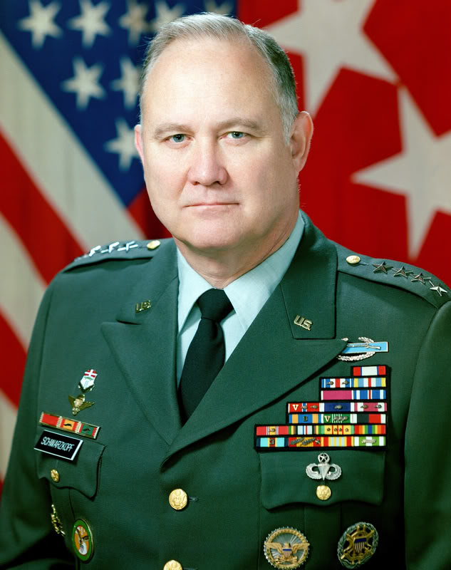
Lesson 3: Developing Your Personal Leadership Style
“Leadership is a combination of strategy and character. If you must be without one, be without the strategy.”
-Gen. Norman Schwarzkopf

Slide 2
What is a leadership style?
For many years leadership has been thought of as a combination of personality traits.
A leadership style is a particular pattern of behavior exhibited by the leader.
you must lead with a style that you are most comfortable with.

Slide 3
What are the three classic styles of leadership?
Leadership has been extensively studied. Three classical styles.
Autocratic: Holds all authority, military in nature, “do it my way, or the highway.” Communication from top to bottom.
Democratic: delegates authority, employee participation, better communication, ”let’s work together” approach.
Laissez-faire: Gives authority with minimum interference, communication flows horizontally, “do it your way” approach. Gives authority to employees.

Slide 4
What is situational leadership?
Situational leadership or contingency theory says that there is “no one best way” to lead a group all the time.
You should adapt your leadership style to the situation based on:
how much loyalty the follower has.
how routine or difficult the task is.
how much formal power the leader has.
Organizations should consider each situation before assigning leaders.
effectiveness of leader in situations will differ.

Slide 5
What are Theory X , Y, z?
Leaders treat followers according to the assumptions they hold.
Theory “X” assumes: Employees dislike work.
employees are only effective if highly controlled.
leader makes ALL of the decisions
Theory “Y” offers a slightly more optimistic view of human nature.
employees accept responsibilities with personal rewards.
more effective as a guide for managerial action.
Theory “Z” focused on building more well rounded employees
cooperative and meaningful coworker relationships
work-life balance

Slide 6
What style of leadership is best?
No one best leadership style exists.
each has its disadvantages and advantages.
The best leadership occurs when the leader’s style matches the situation.
situational leadership is overall best tool.
Effectiveness of your leadership depends on your demonstrating an adequate level of skills.

Slide 7
Best Leadership Style Cont.
Developing your personal style of leadership:
Individual’s exposure & observation.
Trial and error.
Training and education.
Networking with mentors.
Be a lifelong learner to better yourself (there is always room for improvement).

Slide 8
Developing Leadership Skills

Slide 9
Developing leadership Skills
Administrative skills refer to those competencies a leader needs to run and organization.
Managing People: makes connections, understands tasks, and skills needed
Managing Resources: Can include people, money, supplies, equipment, space, or anything else needed to operate an organization.
Showing technical competence: Involves having specialized knowledge about the work we do or ask others to do.

Slide 10
Developing leadership Skills
Interpersonal skills refers to skills a leader needs to work effectively with others.
Being Socially Perceptive: has insight and awareness of what is important to others.
Showing Emotional Intelligence: ability to perceive and express emotion.
Handling Conflict: if done correctly can reduce stress, increase problem-solving and strengthen relationships.

Slide 11
Developing leadership Skills
Conceptual skills refers with a leader being able to communicate ideas, goals, mission, and how to best solve problems.
Problem Solving: ability to correct problem to meet desired objectives.
Strategic Planning: developing plans of action based personnel and resources.
Creating Vision: create a picture of the future and move others toward it.

