Slide 1
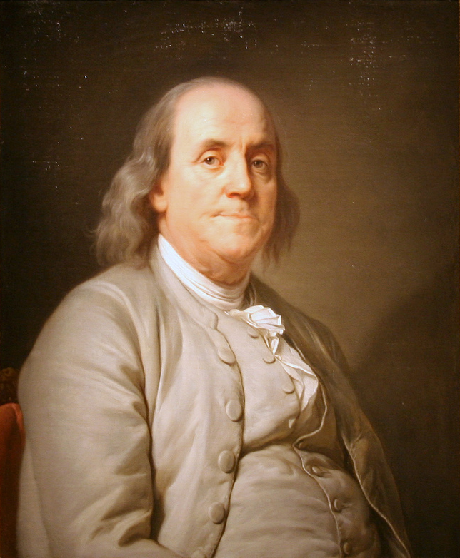
Lesson 6: Time & Meeting Management
“Dost thou love life? Then do not squander time for that is the stuff life is made of.”
-Benjamin Franklin

Slide 2
What is time management?
Time Management: Using the time available to the greatest advantage.
When you are in control of your time you perform better, feel better, and are less stressed
First thing to do in assessing your present time management skills is to see if you have symptoms of poor self management.
Indecisiveness? Procrastination? Always running late for appointments and events?

Slide 3
What are the two governing principles of time management?
First: “Who’s in charge?”
Are you in charge of the events in your life, or are they in charge of you?
You must be in control for effective time management.
Develop the attitude of taking charge and control over the things in your life.
Second: Developing self-mastery of discipline by developing good habits.
“We make our habits, then they make us.”
Acquiring good habits is an ongoing process of identifying and eliminating bad habits then replacing the habits.

Slide 4
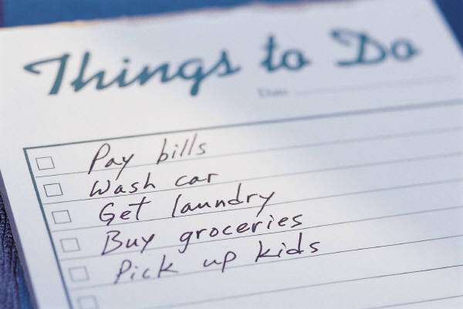
What are some effective time management guidelines?
Create a daily “To Do” list.
Traditional “ABC” list of prioritizing your tasks keeps track of jobs and details.
Develop effective delegation.
Follow up on tasks done by others.
Control & minimize interruptions.
Ask yourself if it is an emergency or not.
Handling phone calls.
Be sociable but don’t waste time. Stand up when important. Write down notes.

Slide 5
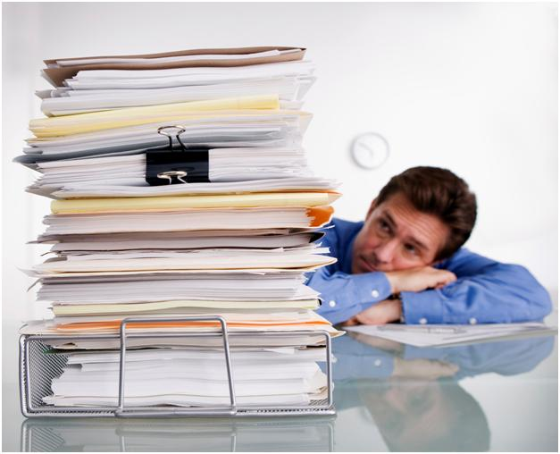
What are some effective time management guidelines?
Take action against procrastination!
If important, JUST DO IT!
Develop rules for handling paper work.
Handle paper work just one time.
Handle it NOW and be done with it.
Use clear and effective communication.
Prepare what you say ahead of time.
Avoid distracting places to talk.
Watch your “Open Door” policy.
Always be mindful of every conversation.
Daily planners ARE A MUST! (Physical reminders)

Slide 6
What are some effective meeting management tools?
For meetings to accomplish results, rules & procedures should be established.
Leader must act as the referee.
Define all issues and goals before the meeting.
Provide research by giving relevant data.
Prepare an agenda.
Keeps meeting on track.
Define limits: Time, authority, policies.

Slide 7
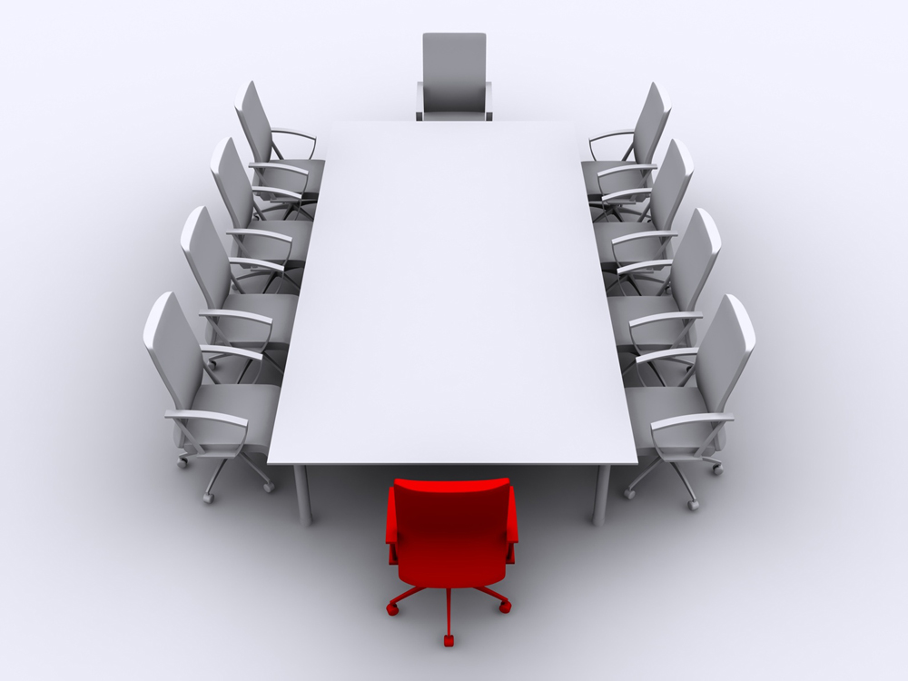
What are some effective time management guidelines?
Prepare the physical facilities (meeting venue). Plan for the unexpected.
Prepare the group members
Send out agenda if necessary.
Keep control over the meeting.
Deal with arguers, private talkers.
Try to involve all in attendance.
Keep records.

Slide 8
Why is delegation an important tool for effective time management?
Delegation: Entrusting an activity to another person.
Downward transfer of power.
Failure to delegate common reason for leadership failure.
Doing more delegation is needed if morale is down, leader is working late, confusion occurs, frequent questions, and deadlines are missed.
Main delegation benefits include freeing up a leaders time, improving worker’s capability, motivation, work distribution, and leadership preparation.
Certain tasks should not be delegated.

Slide 9
What is the five step process of delegation?
The “ICPME” Model of delegation consists of:
Identifying the task to be delegated
Choosing a right person
Preparing the person
Monitoring the progress
Evaluating the results.

Slide 10
ICPME Model
First step is to identify the task to be delegated.
Remember those tasks you shouldn’t delegate.
Hiring, firing, pay issues, policies.
Start off with simple and routine tasks.
Daily duties.
Least critical.
Dislike most.
Performed better by others.
“Where can I best spend my time?”

Slide 11
ICPME Model
The second step is to choose the right person.
Who is an appropriate person for the task?
Assessment of skills and capabilities.
Importance of knowing your people.
Motivational level and desire to learn.
Future leadership screening process.

Slide 12
ICPME Model
Third step is to prepare the person.
Define the boundaries, expectations, expected results, deadlines, authority, and necessary training.
Write down key points.
Be willing to give up some power and control.
Provide necessary resources.

Slide 13
ICPME Model
The fourth step is to monitor the progress.
Allow for growth.
Encourage individuality.
Variety of methods.
Check up carefully without micromanaging.

Slide 14
ICPME Model
The fifth step is to evaluate results.
Evaluate results, not methods.
Remember expectations that were established.
Provide appropriate acknowledgement and recognition.
Keep written record for future use.
Mutually discuss process and experience.

Slide 15
ICPME Model
The leader is still ultimately responsible for the task to be accomplished.
Surround yourself with the best people you can find then delegate effectively.
The key: Recognize and train the right people.

Slide 16
Delegation Wisdom Tidbit #1
“Surround yourself with the best people you can find, delegate authority, and don’t interfere.”
-President Ronald Reagan

Slide 17
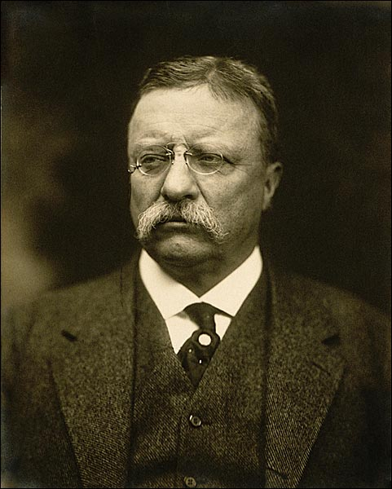
Delegation Wisdom Tidbit #2
“The best executive is the one who has sense enough to pick good men to do what he wants done, and self-restraint enough to keep from meddling with them while they do it.”
-President Theodore Roosevelt

